Slide 1

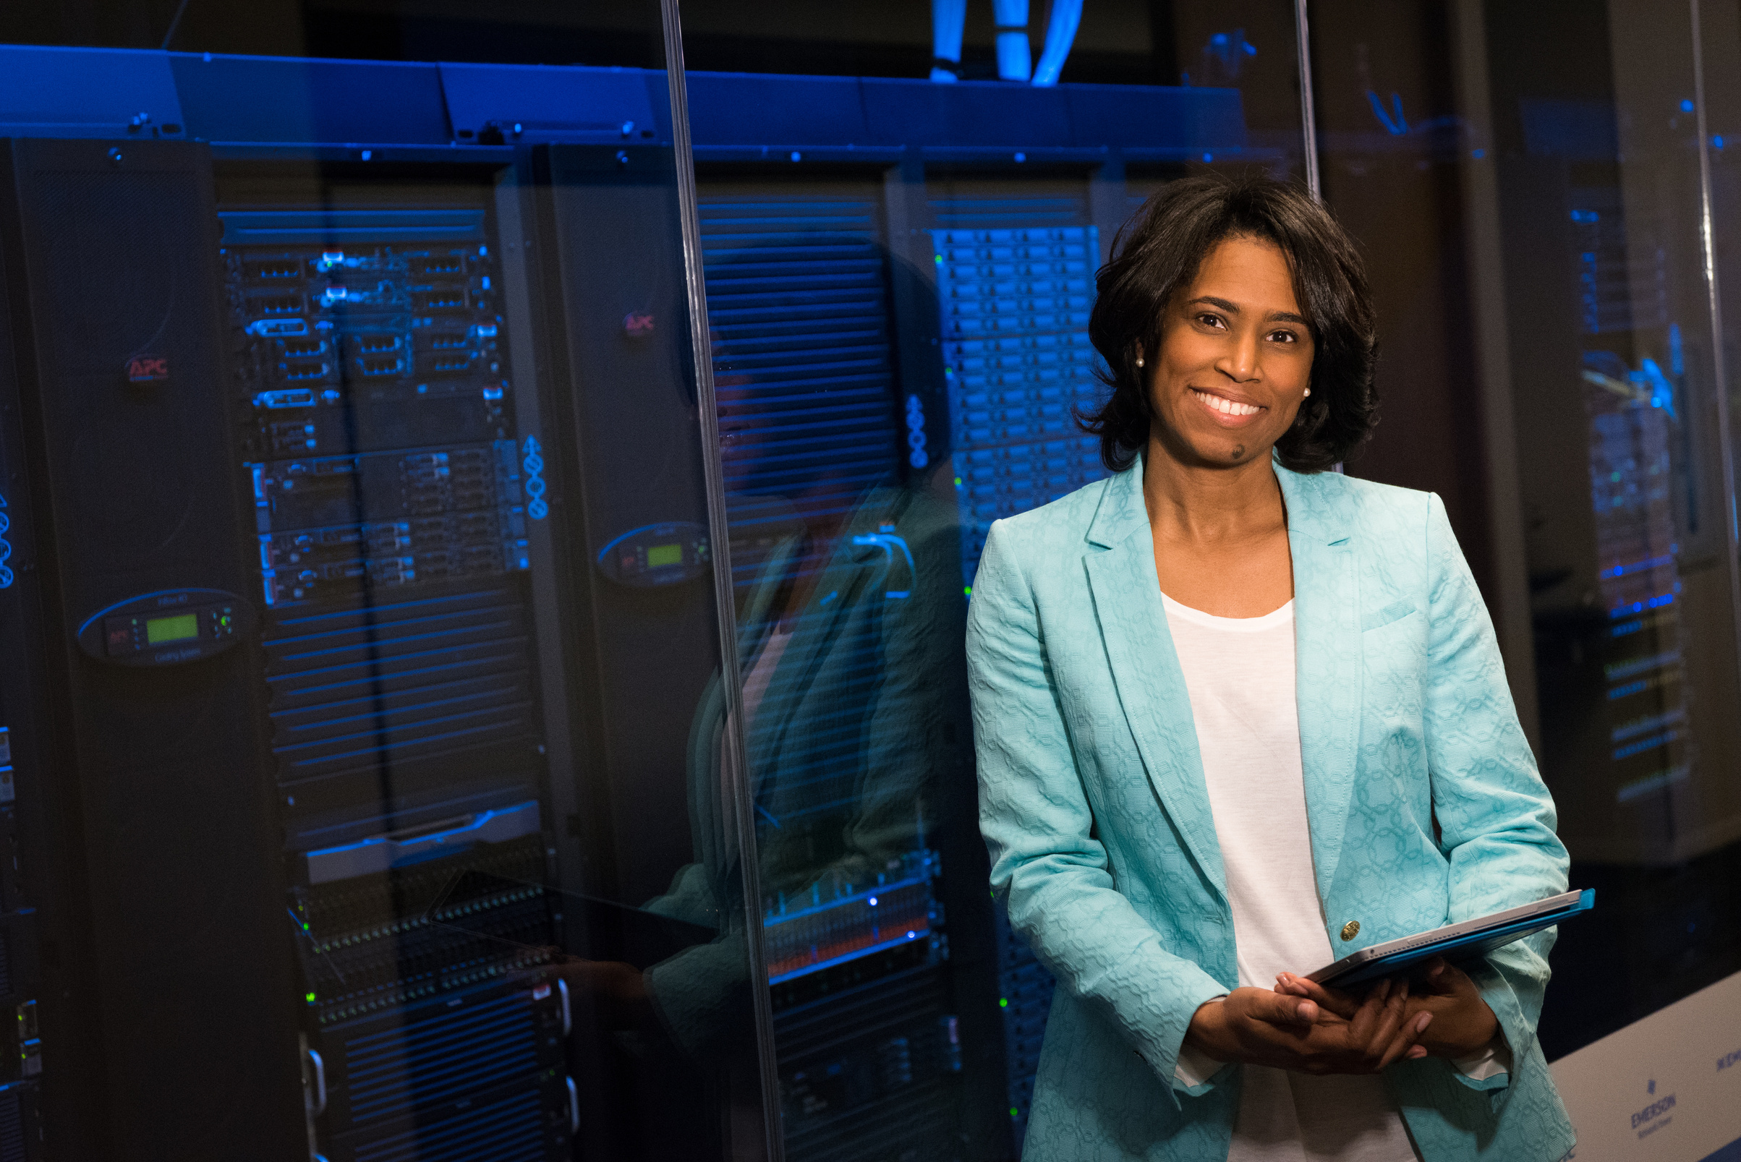

Stenosis Severity Classification
Presentation By: Austin Cherian

Slide 2
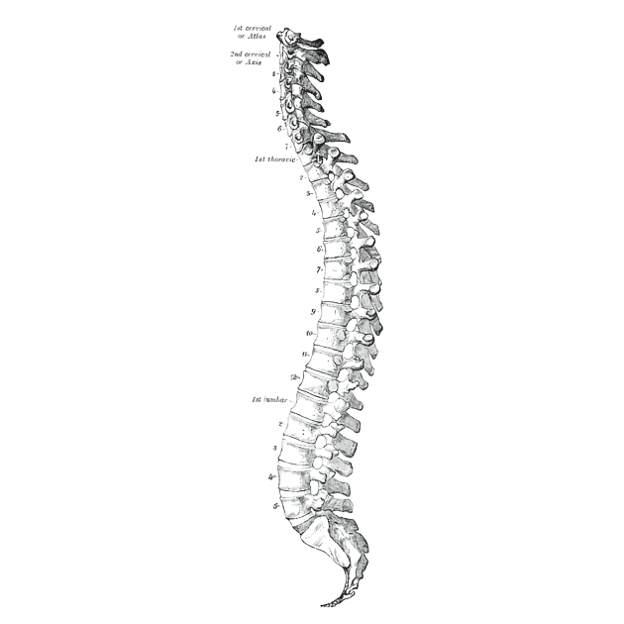

Background and Significance
🏥 The Clinical Challenge
Low back pain is the #1 cause of disability globally, affecting 619 million people in 2020 (WHO).
Most common in aging populations due to degenerative spine conditions, including:
Spinal Canal Stenosis
Neural Foraminal Narrowing
Subarticular Stenosis
🧠 Radiologist Burden
MRI is the gold standard for diagnosing these conditions.
Manual grading is:
Time-consuming
Subjective
Prone to inter-observer variability
🤖 The Opportunity for AI
AI models can:
Support radiologists by automating detection and grading
Standardize interpretation across institutions
Accelerate decision-making for spine care and surgical triage
Data Source: RSNA 2024 Challenge Description (Kaggle)

Slide 3
Dataset
🧬 Dataset Overview Source: RSNA 2024 Lumbar Spine Degenerative Classification Challenge (Kaggle) Organizers: RSNA in collaboration with the American Society of Neuroradiology (ASNR) Scope: Multi-institutional dataset from 8+ hospitals across 5 continents Content: De-identified lumbar spine MRI scans Expert-annotated severity grades (Normal/Mild, Moderate, Severe) Labeled across 5 conditions (L/R foraminal Stenosis, L/R Subarticular Stenosis, Canal Stenosis) and 5 spinal levels (L1/L2, L2/L3, L3/L4, L4/L5, L5/S1) | 🎯 Project Goal Develop a predictive model to classify the severity of spinal degeneration Input: (study_id, condition, level, DICOM slice/mini-stack) → Output: Probability distribution over: Normal/Mild, Moderate, Severe
Data Source: RSNA 2024 Challenge Description (Kaggle)

Slide 4
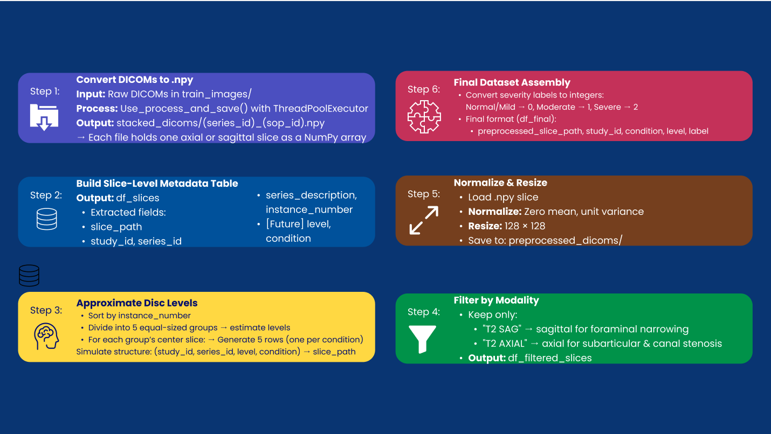
Pre-Processing Steps

Slide 5
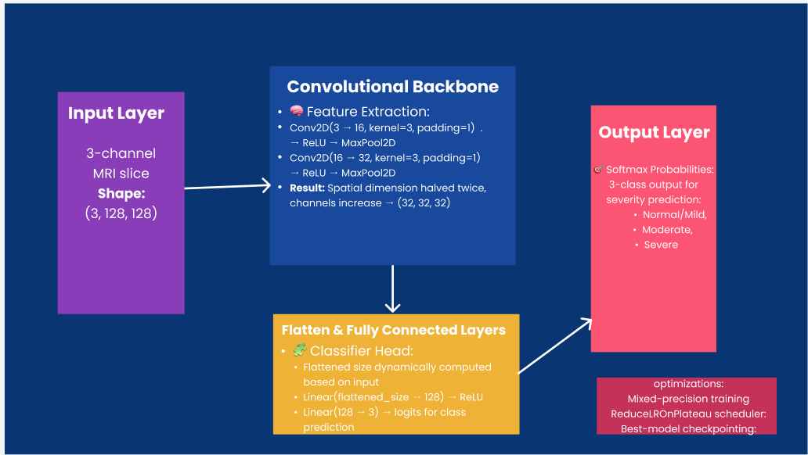
Model Architecture

Slide 6
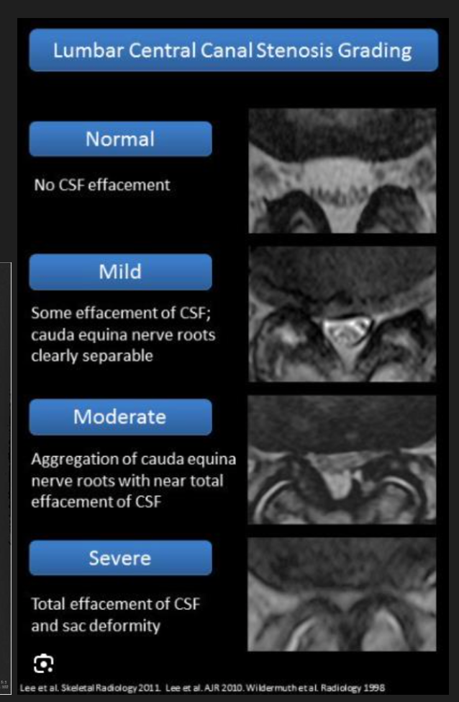
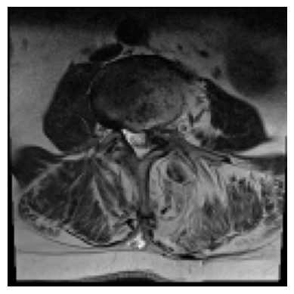
Results
Sorry... no results 🥺
but wait!

Slide 7
Conclusions
🔍 Model Interpretability - can’t speak on that 🙊
⚠️ Limitations
Currently use sagittal and axial interchangeably, but would be better to separate them in different layers
Possible class imbalance (fewer “severe” cases) may bias the classifier toward moderate predictions
‘coordinates’ for slices was not given for test set, so different processing was used to group and categorize them
🛠️ Future Improvements
Integrate attention mechanisms or multi-view fusion for better spatial context
Explore 3D CNNs or transformer-based models to capture volumetric structure

Slide 8
Citations
Tyler Richards, Jason Talbott, Robyn Ball, Errol Colak, Adam Flanders, Felipe Kitamura, John Mongan, Luciano Prevedello, and Maryam Vazirabad.. RSNA 2024 Lumbar Spine Degenerative Classification. https://kaggle.com/competitions/rsna-2024-lumbar-spine-degenerative-classification, 2024. Kaggle.

Slide 9
Thank you for listening!

